Slide 1
ETIOLOGY, PATHOGENESIS, CLINICAL PRESENTATION, DIAGNOSTICS, TREATMENT, AND PROPHYLAXIS OF INDIVIDUAL TEETH POSITION ANOMALIES
Lecture №2

Slide 2
Angle (1889):
1) labial or buccal occlusion; 2) lingual occlusion ; 3) medial occlusion; 4) posterior occlusion; 5) torsion occlusion ; 6) infraocclusion; 7) supraocclusion.

Slide 3
to Simon
1) outside of the normal dental arch;
2) in the middle of the normal dental arch;
3) medially from its normal place;
4) distally from its normal place;
5) above its normal place;
6) in its place, but rotated:
a) around the long axis (the vertical axis of the head);
b) around the transverse axis (of the head); the torsion point lies: near the apex, tooth neck, cutting edge (of the mastication surface);
c) around the sagittal axis; the torsion point lies: by the apex, tooth neck, cut­ting edge (of the mastication surface).

Slide 4
D.A. Kalvelis (1957) .
1. Anomalous position of individual teeth:
a) labiobuccal position of teeth;
b) palatoglossal position of teeth;
c) medial position of teeth;
d) distal position of teeth;
e) low position of teeth (infraocclusion);
f) high position of teeth (supraocclusion);
g) tooth rotation around the longitudinal axis (torsion anomaly);
h) transposition (teeth change places);
i) diastems and diaereses between teeth;
j) compact teeth position (conges­tion).
2. Upper canine teeth allotopia.

Slide 5
V.Y. Kurliandskyi (1957)
— torsion;
— dislocation in the vestibular or oral direction;
— dislocation in the mesial or distal direction;
— violation of the tooth crown location height in the dental arch.

Slide 6
F.Y. Khoroshilkina and Y.M. Malyhin
In the transversal direction:
1) medial or lateral position of frontal teeth;
2) vestibular or oral position of lateral teeth.
In the vertical direction:
1)supraposition of upper teeth or infraposition of lower teeth;
2) supraposition of lower teeth or infraposition of upper teeth.

Slide 7
In the sagittal direction:
1) protrusion or retrusion of frontal teeth;
2) medial or distal position of lateral teeth.
1) tooth rotation around its longitudinal axis;
2) transposition — neighboring teeth exchange places.

Slide 8
VESTIBULAR TEETH POSITION
Etiologic agents :
- irregular follicle anlage;
- early extraction of milk teeth;
- nasal breathing disturbance;
- supplemental teeth;
- inadequacy of teeth crowns to the width of jaws apical basis;
- dental arches narrowing;
- milk molars change delay.

Slide 9
. PALATINE TEETH POSITION
Etiologic agents :
a) interincisor bone underdevelopment;
b) upper jaw anterior part narrowing;
c) alveolar process growth disturbance;
d) supplemental teeth;
e) premature milk teeth extraction;
f) bad habits;
g) nasal breathing disturbance;
h) upper lip, alveolar process, hard palate nonunion;
i) transitional dentition process vio­lation;
j) irregular teeth germs anlage.

Slide 10
LINGUAL TEETH POSITION

Slide 11
DIASTEMA
bad habits;
o late extraction of milk teeth;
o anomalies of the lateral teeth form and size;
o partial adentia;
o anomalous position of the upper lip frenulum;
o supplemental teeth;
o inadequacy of teeth and jaws sizes (big jaws and small teeth).

Slide 12
F.Y. Khoroshilkina (1962) offered diastema types classification.
The first type of diastema.
The second.
The third type.

Slide 13
Types of diastems
1) without axis rotation;
2) with rotation around the axis of the medial surface in the vestibular direction;
3) with rotation around the axis of the medial surface in the oral direction. Such varieties of the central incisors position are met at all diastema types.

Slide 14
TEETH TORSIONS (TORSION ANOMALY)
The anomaly may be caused by:
o irregular permanent tooth germ anlage;
o premature milk tooth extraction with subsequent medial dislocation of distal teeth;
o supplemental teeth;
o a retained tooth;
o dental arches narrowing and lack of space in the dental arch for individual teeth;
o macrodontia.

Slide 15
SUPRAOCCLUSION AND INFRAOCCLUSION

Slide 16
TEETH TRANSPOSITION

Slide 17
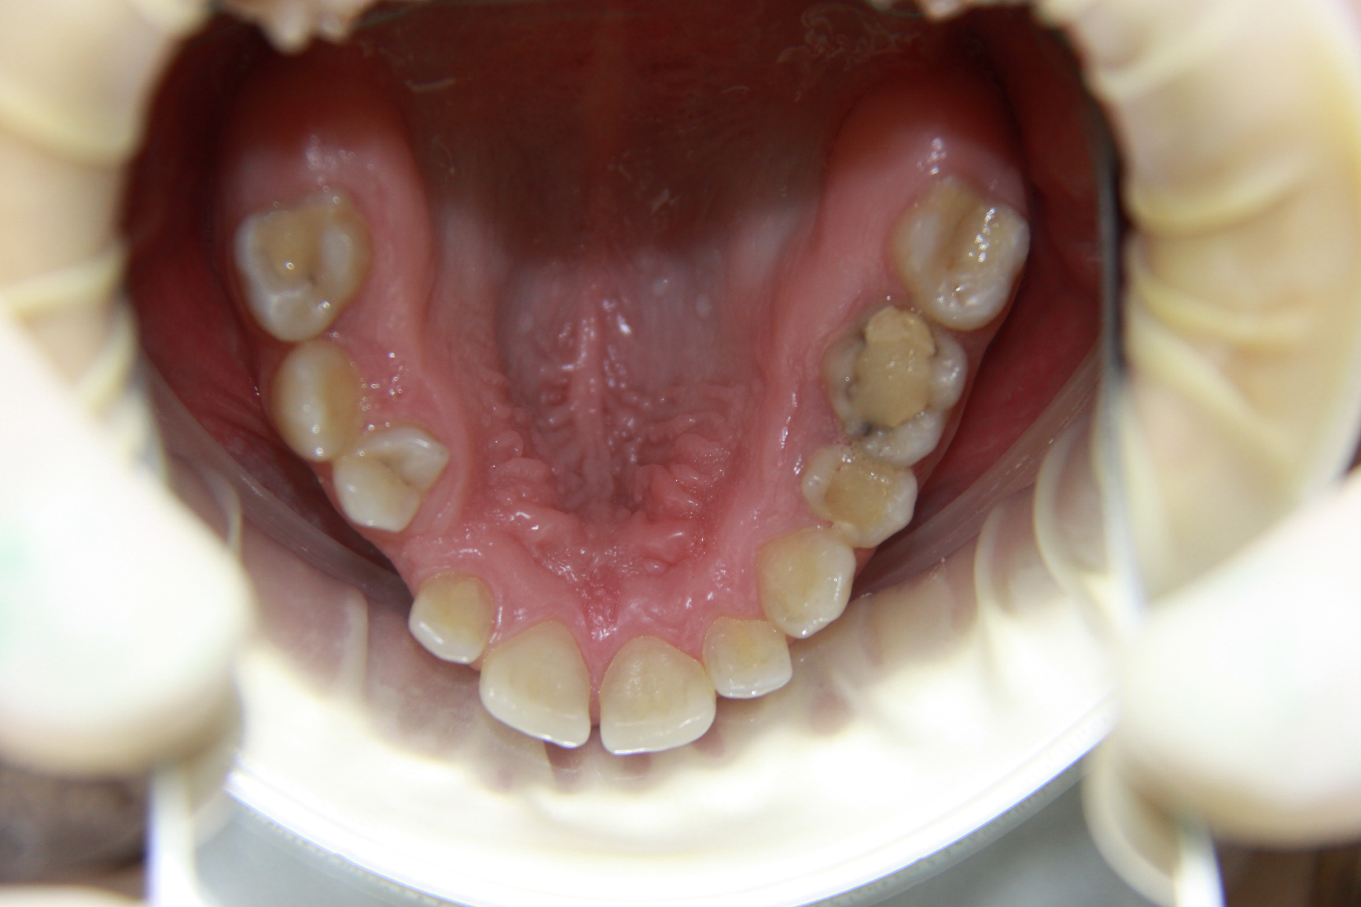

Slide 18
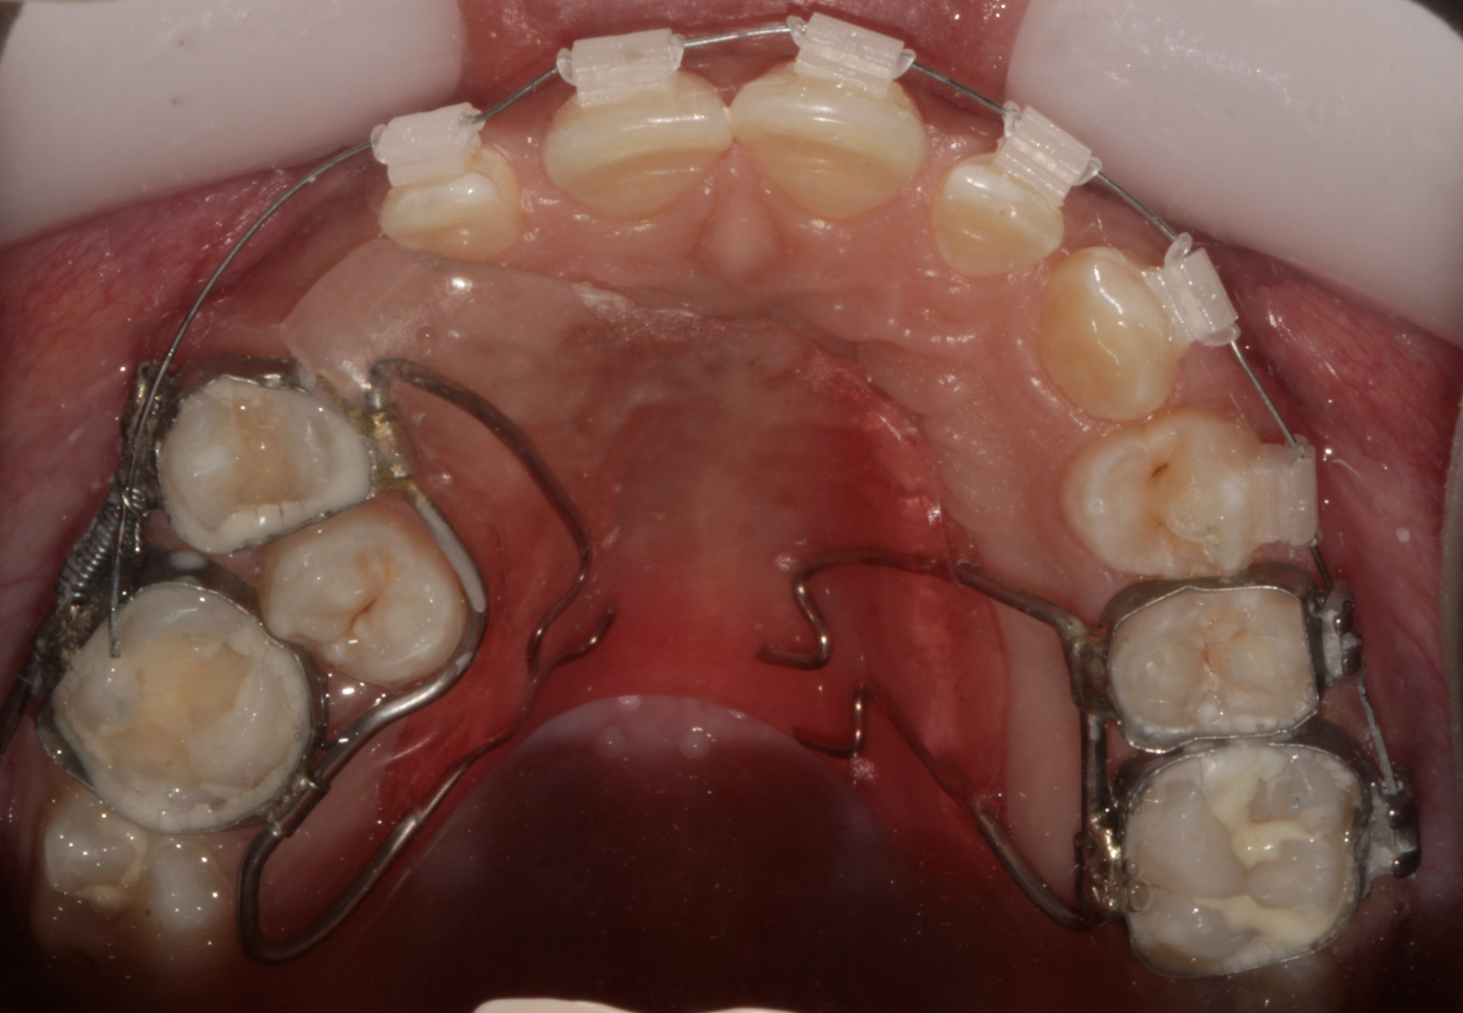

Slide 19
